Slide 1
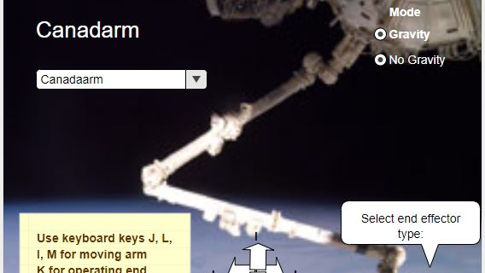

Project SpaceViz
Management Meeting - May 31st. 2019
Satish Mantripragada
Nandu Vellal

Slide 2
Agenda
Functional Model – Apps & Platform
Deployment
Deliverables
Business Model

Slide 3
Functional Model
. . .
Robot Arm
App2
App3
3D
Visualization Software
Platform
(Components)
Cloud Platform
(DigitalOcean)
Database
Compute Engine
(CPU, Memory)
Disk

Slide 4
Deployment
Apps are deployed on the Cloud Platform
Game mode
Education mode will be done later
Apps and its content are provided by organizations like Christa
Writeup on the exhibit (for game mode)
3D models for ISS & Robot arm – sources?
Future integration with any curriculum
Platform is developed and supported by 3DES
Access from both desktop & mobile (tablets)
Controls will be from desktop keyboard & Joystick
Display will be TV or projection unit? - Discussion.

Slide 5
Deliverables - Prototype
First App deployed on the Cloud Platform will be SpaceViz Robot arm
App will work with browser on a Windows desktop
Controls will be both Keyboard & Joystick on desktop
Display will be on TV (anchored on the wall or desk)
Schedule will be 12 weeks (June – 2 weeks in Aug.)

Slide 6
Business Model
Funding the project after August
People – Developer, Support
Resources – Web infrastructure
What about NASA Grant & other sources?
Commercialization Plan
Christa acts as reference site + business partner
Christa only reference site
What about CASIS role?
Pricing model – based on #of users + fixed fee (per site)

